Slide 1
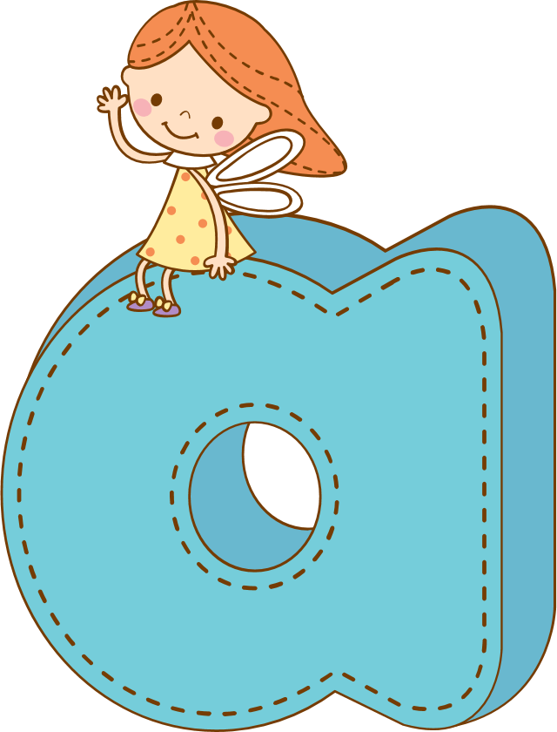
Unit 5:
Work and Play

Slide 2
GUESSING GAME
You look at these pictures and guess the names of subjects.
Each picture in 5 seconds

Slide 3

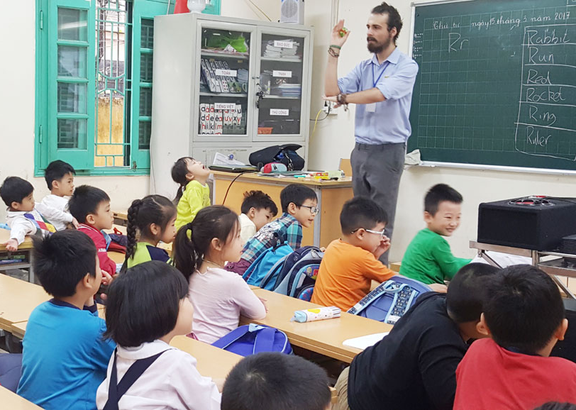
What subject is it?
00
01
02
03
04
05
It’s English.

Slide 4
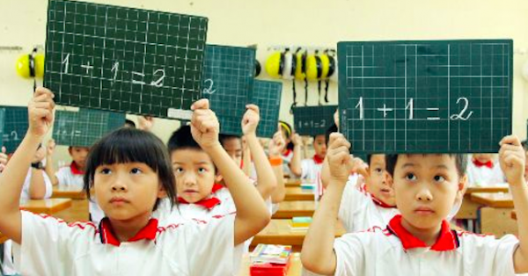
What subject is it?
00
01
02
03
04
05
It’s Math.

Slide 5
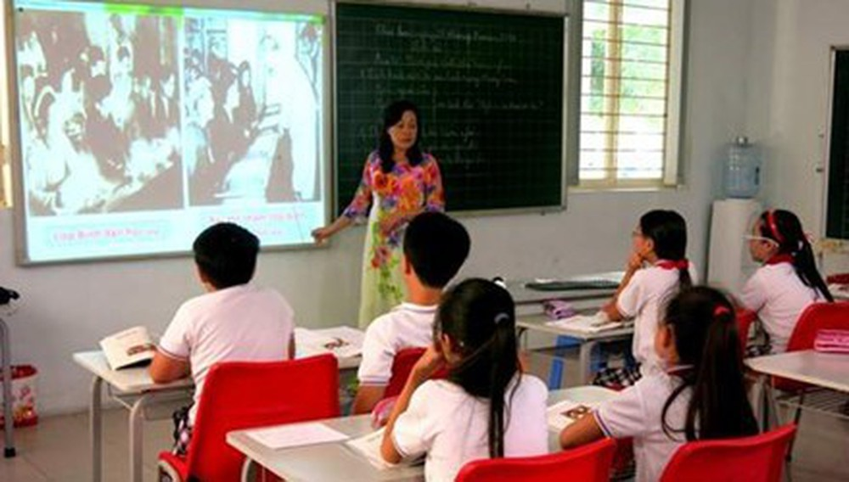
What subject is it?
00
01
02
03
04
05
It’s History

Slide 6
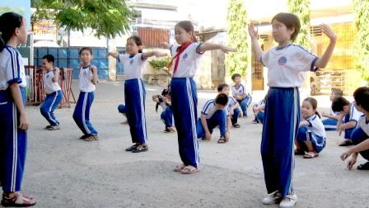
What subject is it?
00
01
02
03
04
05
It’s Physical Education

Slide 7
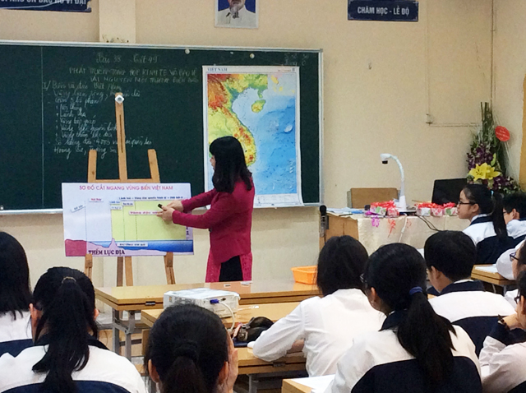
What subject is it?
00
01
02
03
04
05
It’s Geography

Slide 8
02
New words

Slide 9

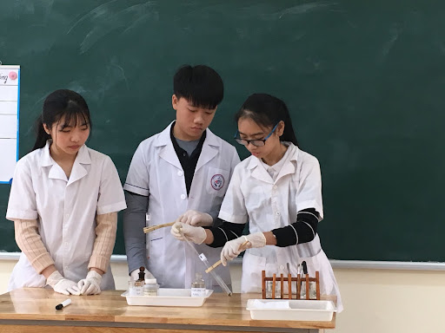

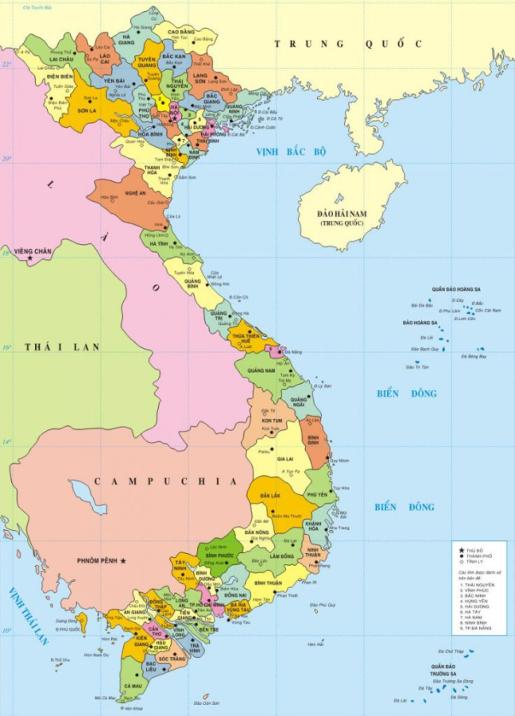

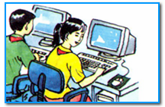
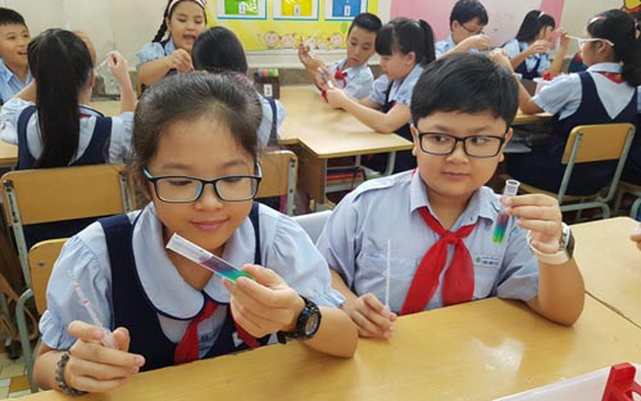


Unit 5: WORK AND PLAY
Part A: In class
Lesson 1: A1
A computer
*New words:
learn (v)
học, học hành
= study (v)
use (v)
sử dụng, dùng
computer (n)
máy tính
Computer Science
môn Tin học
These students learn how to use computers in Computer Science class.
interested (adj)
thích , quan tâm
= wanting to give your attention to something and discover more about it
be interested in
map (n)
bản đồ
experiment (n)
cuộc thí nghiệm
do an experiment
thí nghiệm

Slide 10
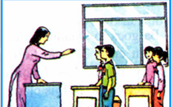
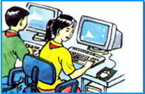
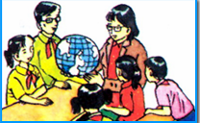

Mai is a student at Quang Trung school. She is in grade 7. She goes to school six days a week, from Monday to Saturday.
Classes always begin at seven o’clock and finish at a quarter past eleven.
At school, she learns about lots of different things.
She learns how to use a computer in her Computer Science class.
Mai is very interested in computers. This is her favorite class.
In her Geography class, she studies maps and learns about different countries.
Mai thinks Geography is difficult.
Today, Mai’s last lesson is Physics. She does some experiments.

Slide 11
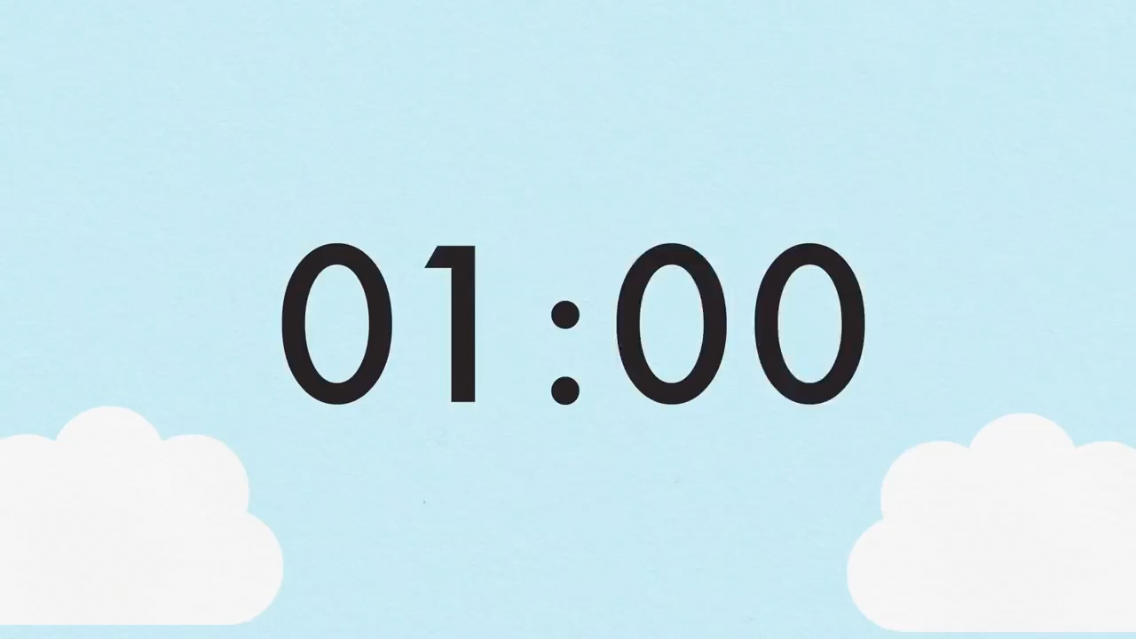
Now ask and answer five questions about Mai.
Example:
What does Mai study in her Geography class?
She studies maps and learns about different countries.
What is Mai’s favorite class?
Her favorite class is Computer Science.
Now your turn

Slide 12


Now ask and answer five questions about Mai.
1
What does Mai do?
She is a student.

Slide 13
Now ask and answer five questions about Mai.
2
What school does she go to?
She goes to Quang Trung school.

Slide 14
Now ask and answer five questions about Mai.
3
Which grade is she in?
She is in grade 7.

Slide 15
Now ask and answer five questions about Mai.
4
How often does she go to school?
She goes to school six days a week.

Slide 16
Now ask and answer five questions about Mai.
5
Is she interested in Computer Science?
Yes, she is.

Slide 17


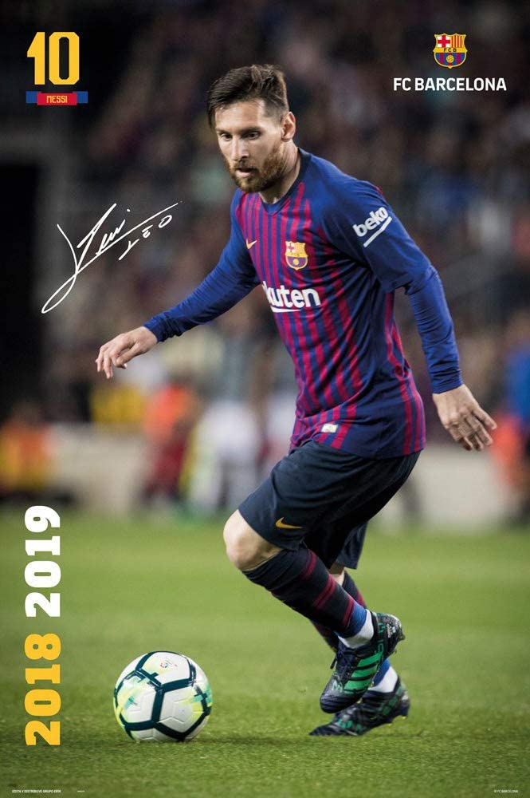
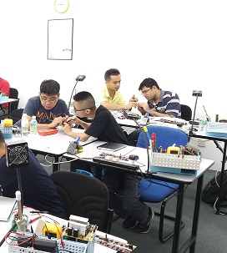
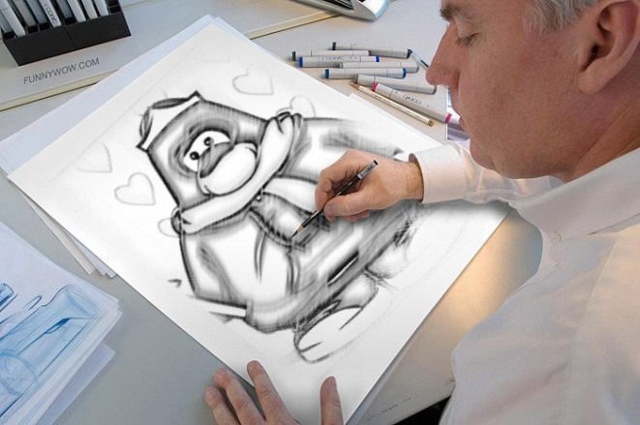
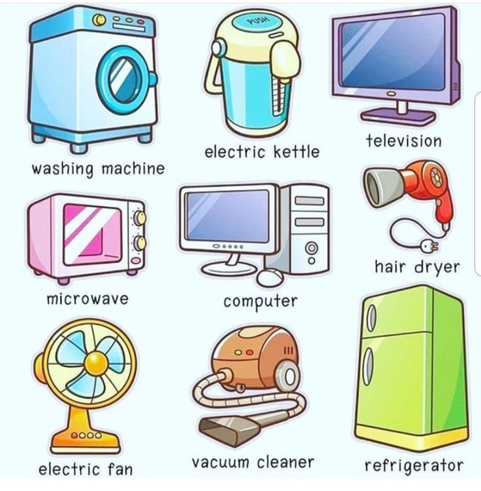



Unit 5: WORK AND PLAY
Part A: In class Lesson 2: A2
New words:
enjoy (v)
= thích/ yêu thích
Electronics (n)
= môn Điện tử
repair (v)
= sửa chữa
like / love
household appliance (n)
= thiết bị điện gia dụng
= fix (v)
He can fix the washing machine.
= He can repair the washing machine.
He likes to draw. He draws everyday.
draw (v)
= vẽ
His drawing is very nice.
drawing (n)
= tranh vẽ
be good at + Noun
= giỏi về việc gì
Messi is good at soccer.
Messi is good at playing soccer.
be good at + V-ing
= giỏi về làm việc gì

Slide 18




Fill in the blank with a suitable word from the box:
household appliances - repair - good at enjoy - drawings - Electronics
Electronics
In the …………………class, they learn to……..…… the televisions and the lights.
Nam is……………....... Art, so his ………………are very beautiful.
3. The washing machine is one of the….…………………...
4. I go swimming every morning.
I………………….swimming very much.
repair
good at
drawings
household appliances
enjoy

Slide 19
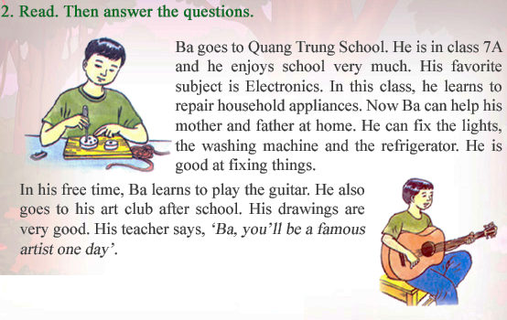

Slide 20



QUESTIONS
a. Which subject does Ba like best?
He likes Electronics best.
b. Does Ba like other subjects at school? Write the sentence that tells you this.
Yes, he does. “He enjoys school very much.”
c. What does he learn to do in Electronics ?
He learns to repair household appliances.
d. How does this subject help Ba?
He can fix his own household appliances.
e. Is Ba good at drawing? Write the sentence that tells you this.
Yes, he is. “ His drawings are very good.”

Slide 21


*About you.
f) What do you do in your free time?
g) What are you good at?
h) What is your favorite subject?
*Take a survey.
Name | Activities | Good at | Subjects
Tram | watch TV | Music | English

Slide 22



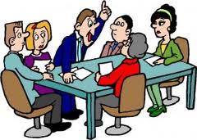



2
the same (adv)
Giống nhau
period (n)
Giai đoạn
instead (adv)
Thay vì
class activity
Hoạt động trong lớp
essay (n)
Bài văn
event (n)
Sự kiện, tiết mục
as well:
Cũng được

Slide 23


Checking
2
instead (adv)
Giống nhau
as well
Giai đoạn
essay (n)
Thay vì
class activity
Hoạt động trong lớp
period (n)
Bài văn
event (n)
Sự kiện, tiết mục
the same (adv)
Cũng được

Slide 24
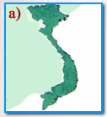
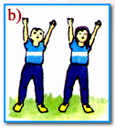
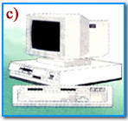
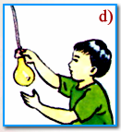
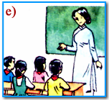

3
Geography
Physical Education
Computer Science
Technology
Class activity

Slide 25

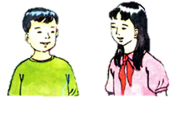

Listen. Then write the correct letters next to the names.
3
d,a,e
c,b,e
Ba: ………… Hoa:……….

Slide 26
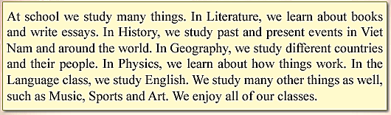

3
Read the passage

Slide 27

3
Discuss with a partner to find the ODD ONE out.
author
LITERATURE
stories
writing
paintings

Slide 28
3
Discuss with a partner to find the ODD ONE out.
Basketball games
HISTORY
Famous people
World events
Important days

Slide 29
3
Discuss with a partner to find the ODD ONE out.
SCIENCE
Experiments
Meter
Preposition
Temperature

Slide 30
3
Discuss with a partner to find the ODD ONE out.
ENGLISH
Words
Verbs
England
Pronouns

Slide 31

Literature
History
Science
English
author, writing, stories
famous people, world events, important days
experiments, meter, temperature
words, verbs, pronouns
Write down in the notebooks.

Slide 32


4
Homerwork
Learn by heart new words.
Review the names of subjects.
Read the passage A125 again.
Prepare for new lesson: B1&B3

Slide 33
Thank you!

